Slide 1



Soccer Analytics
Literature Review

Slide 2
Literature: Spatio-tempoal Dataset
Pappalardo, Luca, et al. “A Public Data Set of Spatio-Temporal Match Events in Soccer Competitions.” Scientific Data, vol. 6, no. 1, 2019, doi:10.1038/s41597-019-0247-7.
Public soccer event logs from Wyscout
Data quality controlled through 3 step validation by human analysts
Covers the five most popular European leagues in 2017/18, the European Cup 2016, and the World Cup 2018
Events correspond to players involved, time, position(s), event outcome, and other specialized event tags
Each ball touch maps to an event
Limitation: Off ball events, such as pressing and man marking, are not covered

Slide 3
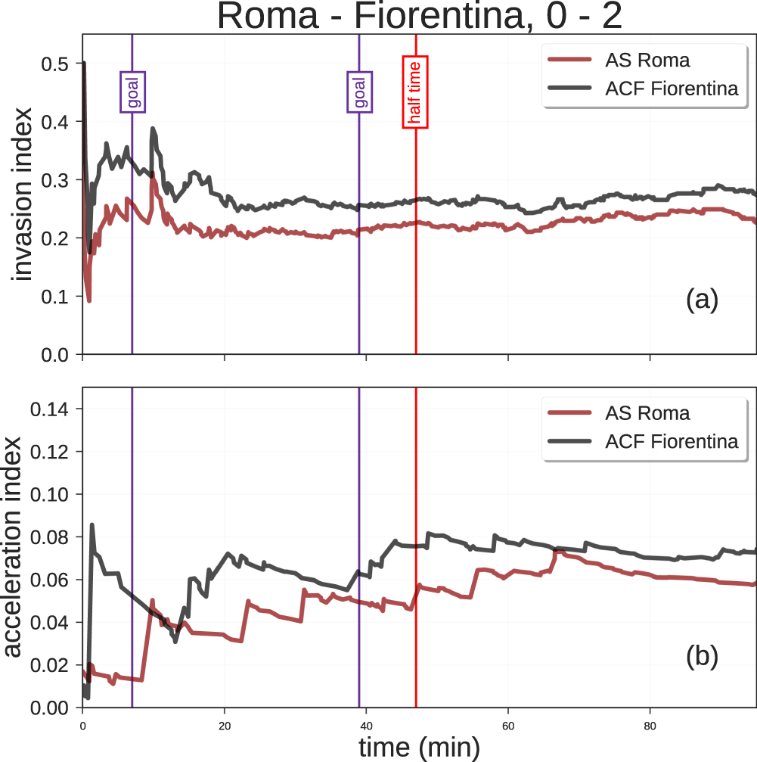
Literature: Spatio-tempoal Dataset
Pappalardo, Luca, et al. “A Public Data Set of Spatio-Temporal Match Events in Soccer Competitions.” Scientific Data, vol. 6, no. 1, 2019, doi:10.1038/s41597-019-0247-7.
Suggest two analysis metrics (derived from the dataset) to study:
Invasion Index: “Dangerousness”
Acceleration Index: “Speed of play“
Possible Extension: Deep dive into the Invasion Index and Accelaration Index, and explore possibilities for developing other performance metrics

Slide 4
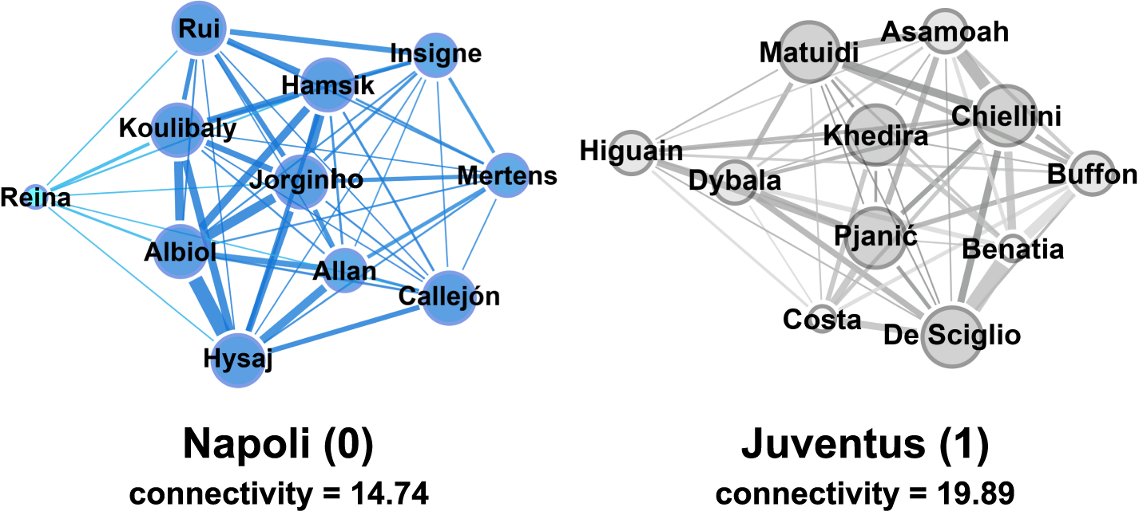
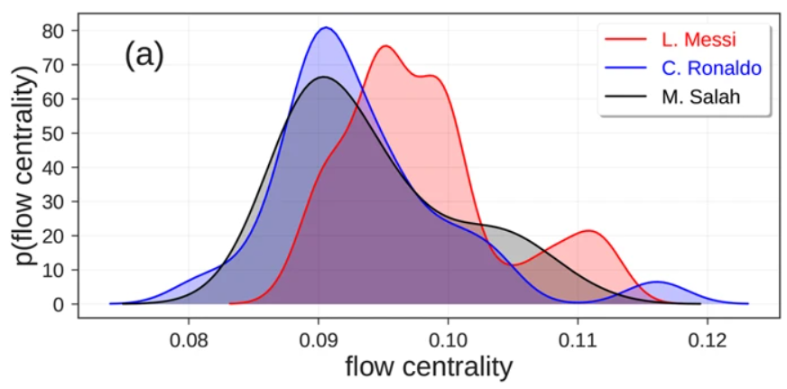
Literature: Spatio-tempoal Dataset
Pappalardo, Luca, et al. “A Public Data Set of Spatio-Temporal Match Events in Soccer Competitions.” Scientific Data, vol. 6, no. 1, 2019, doi:10.1038/s41597-019-0247-7.
Study team passing through a graph analysis of the team
The edges represent the passing volume between players
Connectivity measures team robustness
Flow centrality measures the corresponding player’s contribution to the passing network’s robustness
Possible Extension: Explore algorithms in graph theory to get more information out of passing networks

Slide 5
Literature: Playerank
Pappalardo, Luca, et al. “PlayeRank.” ACM Transactions on Intelligent Systems and Technology, vol. 10, no. 5, 2019, pp. 1–27., doi:10.1145/3343172.
Multidimensional, role aware player ranking algorithm using a statistical approach
The algorithm uses linear models on features constructed from event logs, along with a clustering algorithm to assign roles
Validation is performed through a cross comparison with scouting professionals
Result: 30% (relative) or 21%(absolute) improvement over the time’s state of the art ranking algorithms
Applications include:
Querying highest ranked players within particular zones on the field
Quantifying player versatility

Slide 6
Literature: UNDERSTANDING HUMAN GENERATED PLAYER RATINGS
Pappalardo, Luca & Cintia, Paolo & Pedreschi, Dino & Giannotti, Fosca & Barabasi, Albert-Laszlo. (2017). Human Perception of Performance.
Deep dive on understanding human generated player ratings
Technical performance data from event logs (processed as a multidimensional vector of z-scores) is mapped to player ratings from newspapers
A machine learning model is built to replicate human judgement in order to understand feature importance
Key findings:
Contextual information is very powerful in determining human generated ratings. Technical features alone are insufficient.
Human judges rely on a noticeability heuristic – they select a limited number of noticeable features to make their judgement
Key features highly depend on player role

Slide 7
Literature: H-Statistic
P. Cintia, F. Giannotti, L. Pappalardo, D. Pedreschi and M. Malvaldi, "The harsh rule of the goals: Data-driven performance indicators for football teams," 2015 IEEE International Conference on Data Science and Advanced Analytics (DSAA), Paris, 2015, pp. 1-10, doi: 10.1109/DSAA.2015.7344823.
Construct a metric, the H statistic, to quantify passing amongst players and across spatial zones on the field
Explore descriptive and predictive power in the metric and its constituents
Simulate leagues based on this metric alone
Key findings:
The H statistic shows significant correlation (0.7-0.8) with number of goals, attempts, and points
The difference in H statistic strongly maps to match outcome
A classifier based on past H statistic values can predict game outcomes with up to 60% accuracy
Rankings for leagues simulated on these classifiers highly correlate with actual end of season rankings, with coefficients ranging from 0.66 to 0.84
Anomalies in rankings can be explained by extreme Pezzali scores
Possible Extensions: Append the H-Statistic with more detailed passing information, beyond the six indicators explored in the paper, to see if significant improvement in the descriptive/predictive power can be achieved

Slide 8
More Data sources
EA player statistics and attributes (exhaustive) updated weekly at https://sofifa.com/
League statistics and ratings (weekly) at https://www.whoscored.com/
Betting odds for every game, at https://www.kaggle.com/hugomathien/soccer

